Slide 1
What is Project Scope Management?
Scope refers to all the work involved in creating the products of the project and the processes used to create them
A deliverable is a product produced as part of a project:
hardware
Software
planning documents
meeting minutes
Project scope management includes the processes involved in defining and controlling what is or is not included in a project

Slide 2
Project Scope Management Processes
Collecting requirements:
defining and documenting:
features and functions of the products produced
processes used for creating them
Defining scope:
reviewing the project charter
requirements documents
organizational process assets to create a scope statement
Creating the WBS:
subdividing the major project deliverables into smaller, more manageable components
Verifying scope:
formalizing acceptance of the project deliverables
Controlling scope:
controlling changes to project scope throughout the life of the project

Slide 3
Assignment: Gathering Information
Given that you have just been assigned as project Manager for a Network System installation (servers, routers, switches, cabling, desktops etc.) what are the avenues to gathering information in this regard.
Prepare to discuss.

Slide 4
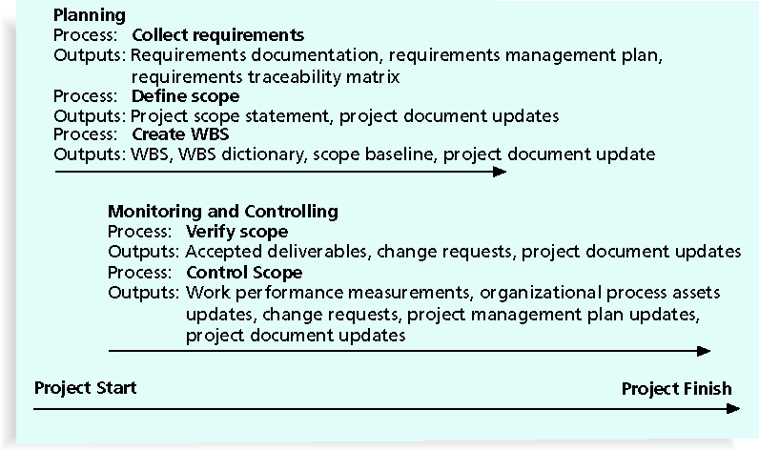
Project Scope Management Summary

Slide 5
Collecting Requirements
A requirement is “a condition or capability that must be met or possessed by a system, product, service, result, or component to satisfy a contract, standard, specification, or other formal document” (PMBOK® Guide, 2008)
It is important to use an iterative approach to defining requirements since they are often unclear early in a project

Slide 6
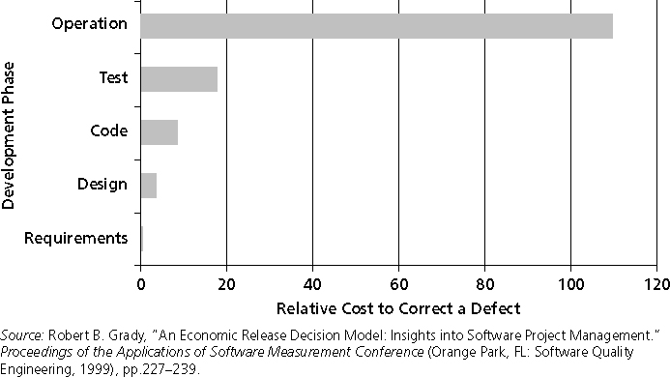
Relative Cost to Correct a Software Requirement Defect

Slide 7
Methods for Collecting Requirements
Interviewing
Focus groups and facilitated workshops
group creativity and decision-making techniques
Questionnaires and surveys
Observation
Prototyping
Software tools

Slide 8
Software to formulate requirements
Genesys Telecommunications Laboratories uses Accept software, a product planning and innovation management application and winner of the Excellence in Product Management Award from 2006–2008
http://www.accept360.com/
Accept helps instill:
Consistent
Repeatable
predictable process for new product definition and development
They define what information comprises a requirement and enforce discipline around that process
Eliminating Requirements Chaos
“Too many requirements. Too many places. Learn how Accept Requirements creates a living repository of information that ties together market, customer, competitive, and requirements data in a proven market model framework—what’s important to your customers, grows your top line, and beats your competitors–so you can create insight from chaos.” https://secure.accept360.com/resources/library/previews.cfm

Slide 9
Documenting Requirements
Requirements documents generated by software include text, images, diagrams, videos, and other media; broken down into categories:
functional
Service
Performance
Quality
training requirements etc.
A requirements management plan describes how project requirements will be:
Analyzed
Documented
managed
A requirements traceability matrix (RTM) table that lists
Requirements
various attributes of each requirement
status of the requirements to ensure that all requirements are addressed

Slide 10
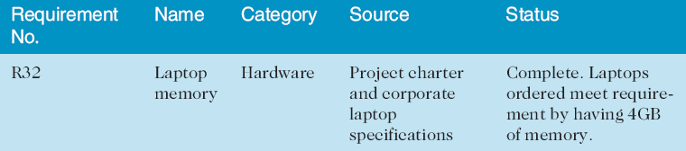
Sample Requirements Traceability Matrix

Slide 11
Defining Scope
Key inputs for preparing the project scope statement include:
project charter
requirement documentation
organizational process assets:
policies and procedures related to scope statements,
project files
lessons learned from previous, similar projects
As time progresses, the scope of a project should become more clear and specific

Slide 12
Scope Statement Outputs
The Scope statement describes, in detail, deliverables and work required to create the deliverables. Details helps with the team define the scope accurately.
Product Scope Statement
Product Acceptance Criteria
Project Deliverables
Project Exclusions
Project Constraints
Project assumptions associated with scope
Project Documentation Updates

Slide 13
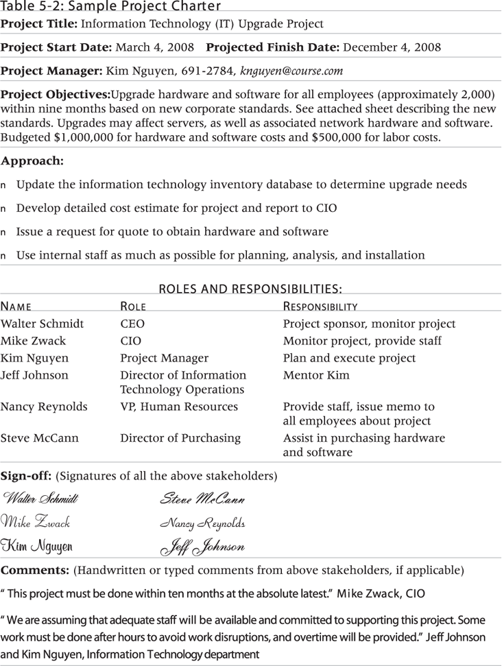
Sample Project Charter

Slide 14
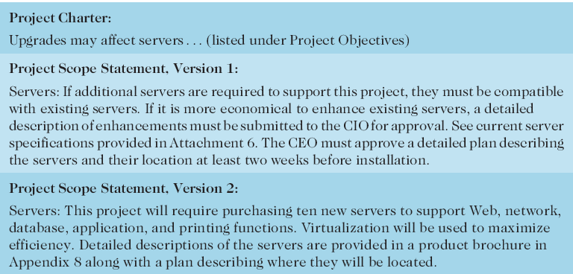
Further Defining Project Scope

Slide 15
Media Snapshot
Many people enjoy watching television shows like Trading Spaces, where participants have two days and $1,000 to update a room in their neighbor’s house; since the time and cost are set, it’s the scope that has the most flexibility
Although most homeowners are very happy with work done on the show, some are obviously disappointed; part of agreeing to be on the show includes signing a release statement acknowledging that you will accept whatever work has been done

Slide 16
Creating the Work Breakdown Structure (WBS)
A WBS is a deliverable-oriented grouping of the work involved in a project that defines the total scope of the project
WBS is a foundation document that provides the basis for planning and managing:
project schedules
Costs
Resources
Project changes
Decomposition:
subdividing project deliverables into smaller pieces
work package:
is a task at the lowest level of the WBS

Slide 17
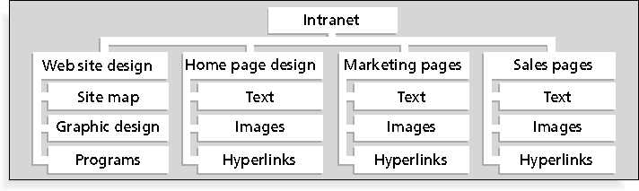
Sample Intranet WBS Organized by Product

Slide 18
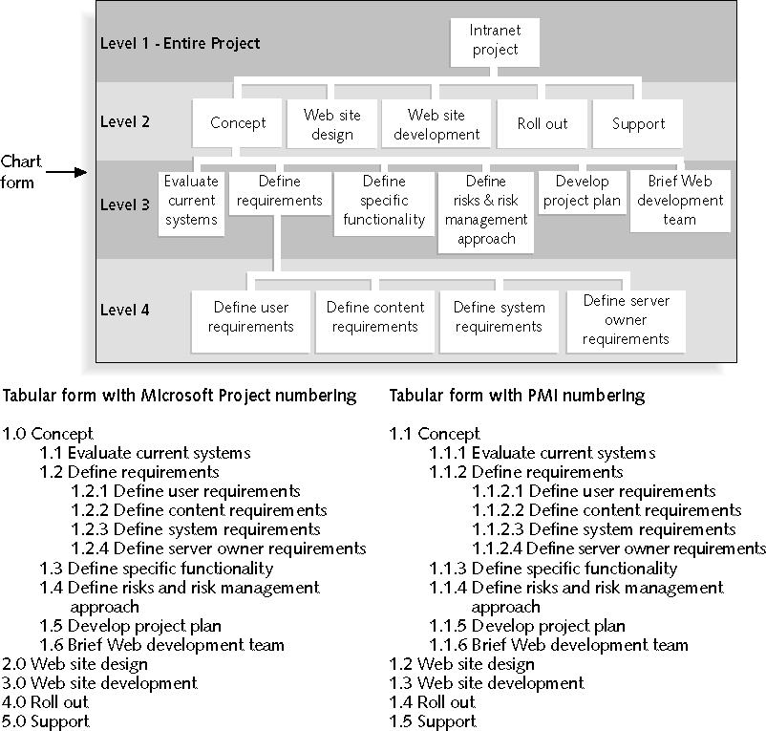
Sample Intranet WBS Organized by Phase

Slide 19
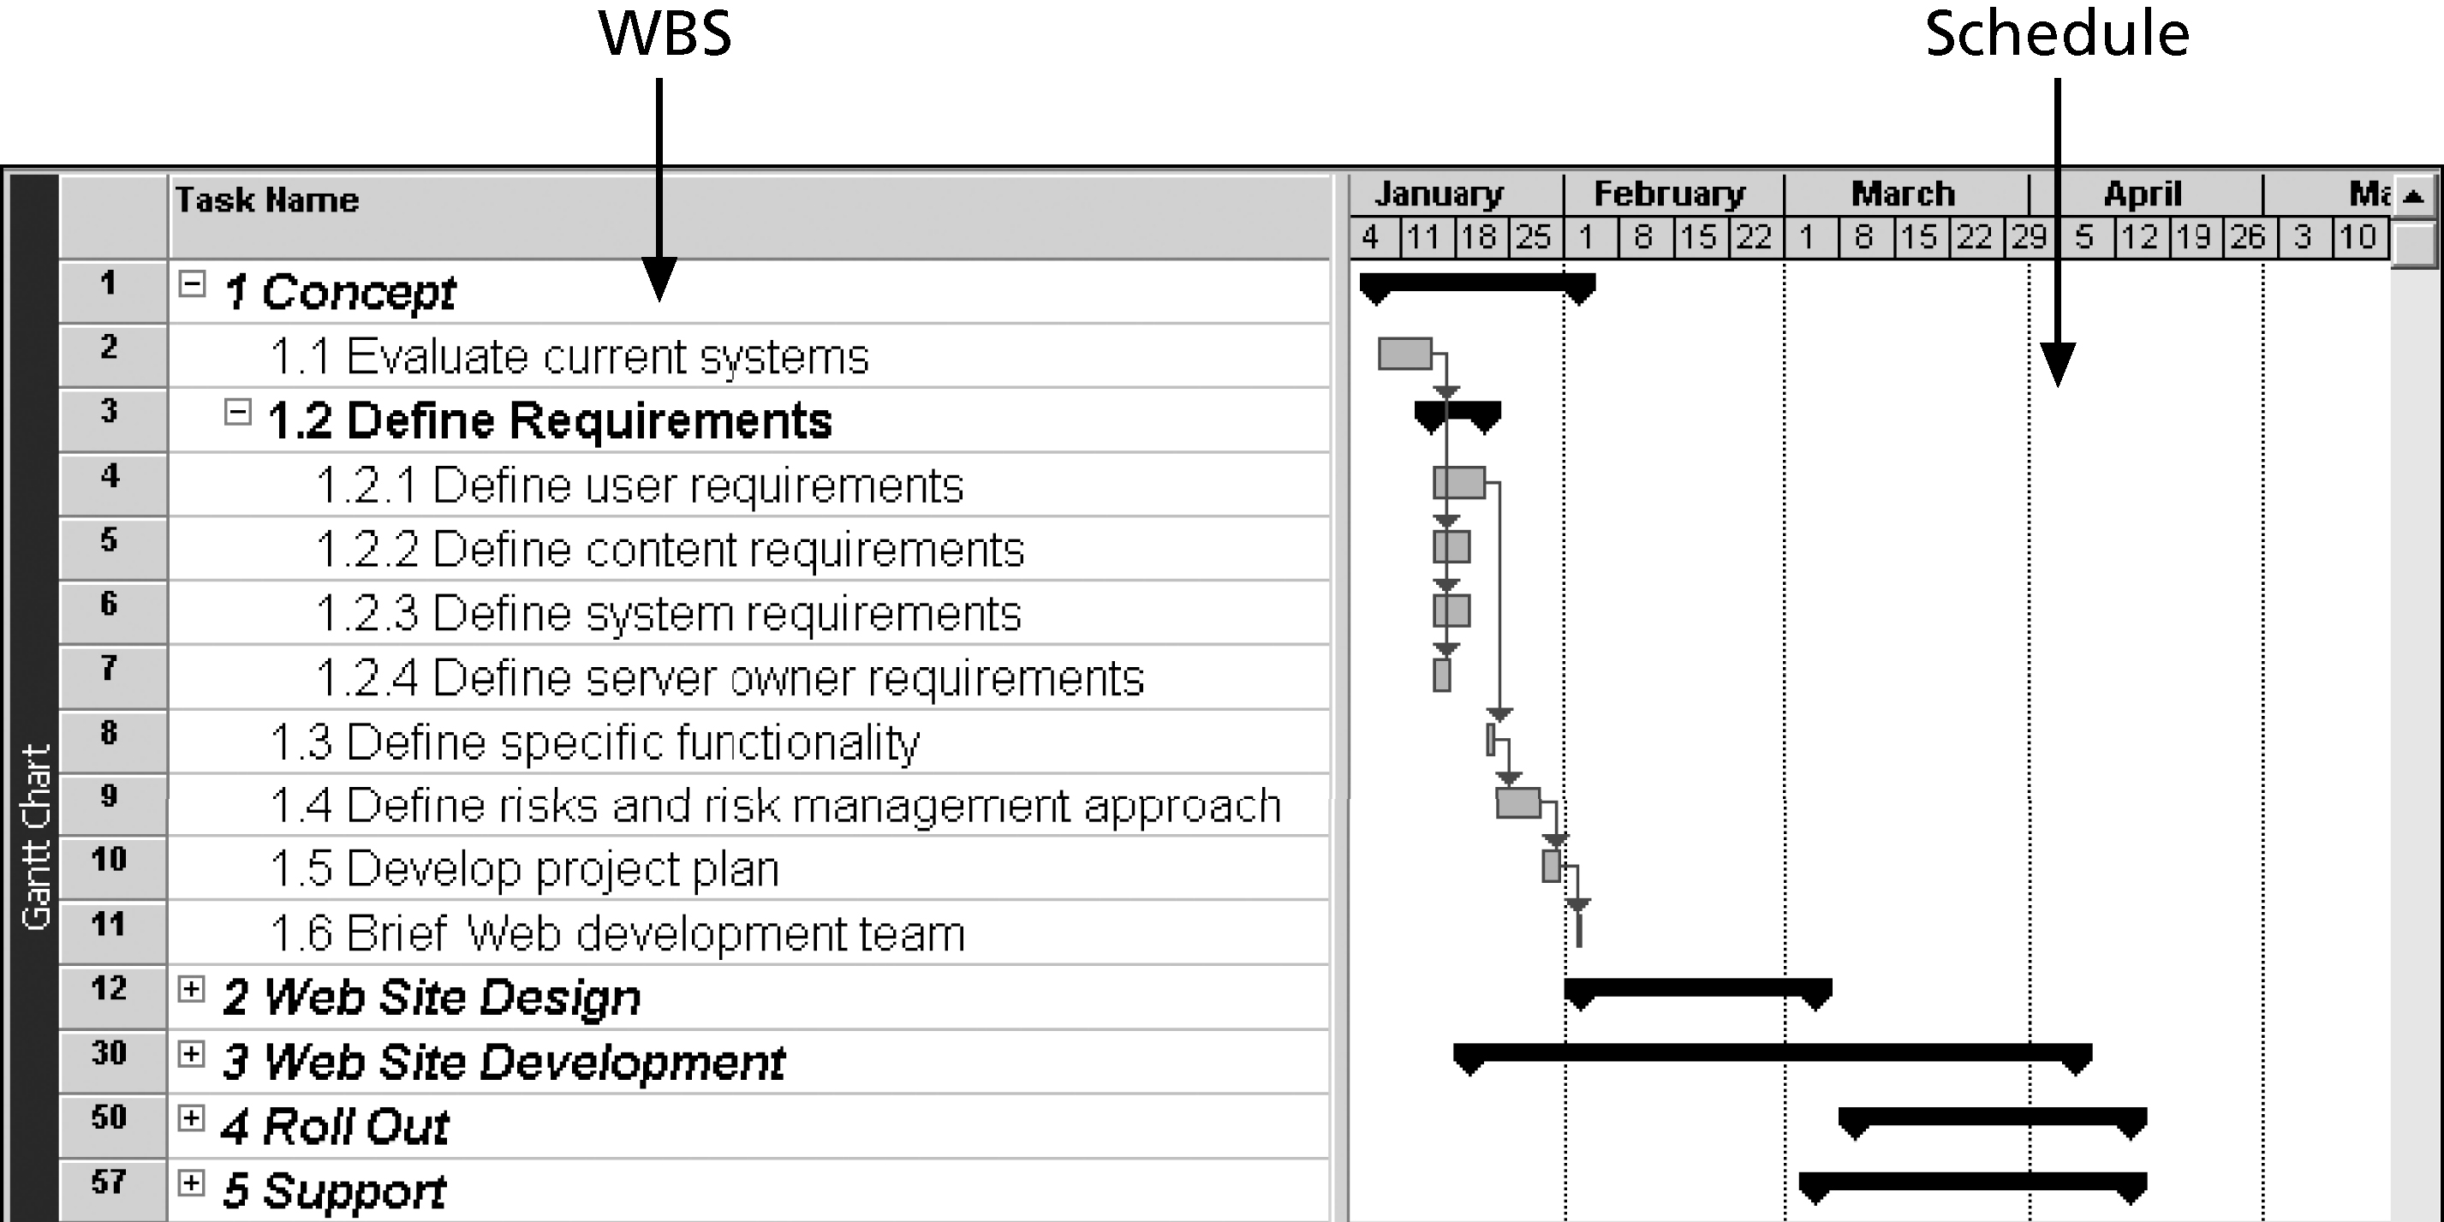
Intranet WBS and Gantt Chart in Microsoft Project Phase

Slide 20
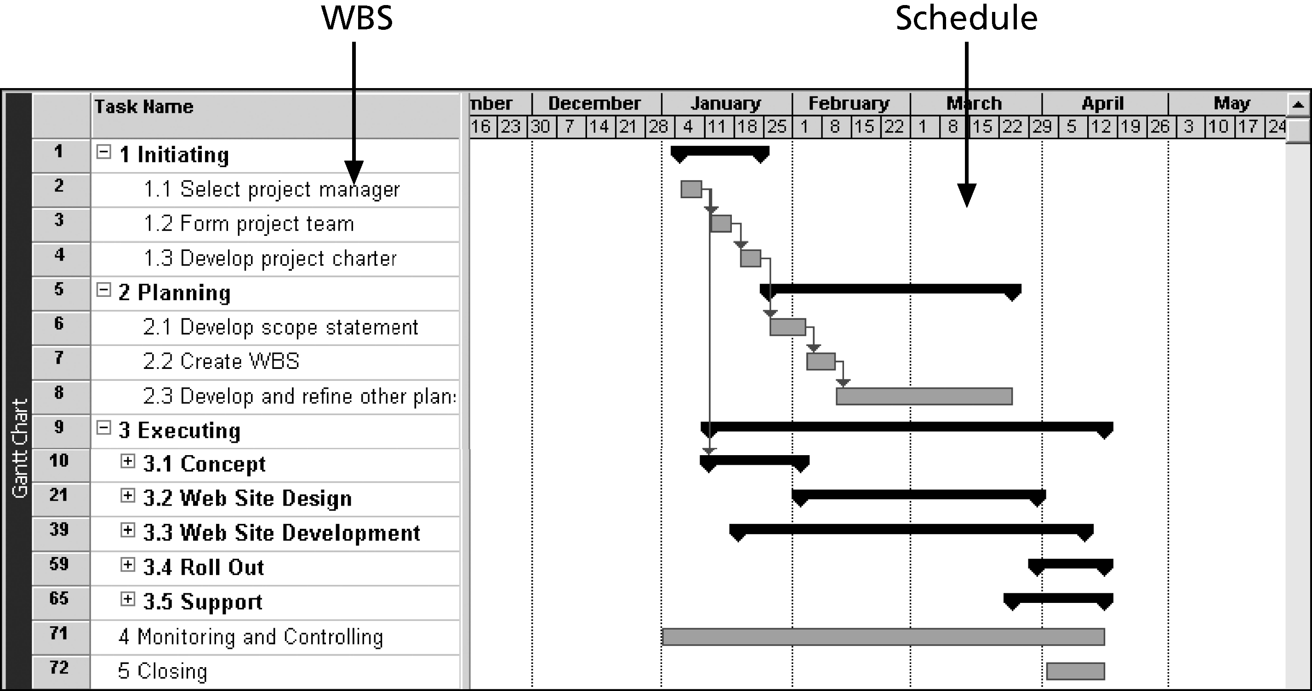
Intranet Gantt Chart Organized by Project Management Process Groups

Slide 21
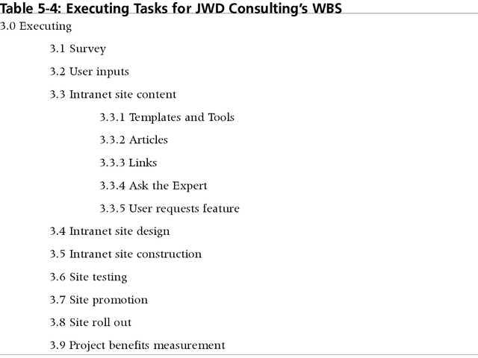
Executing WBS

Slide 22
Approaches to Developing WBSs
Using guidelines: some organizations, like the DOD, provide guidelines for the preparing WBS
The analogy approach: review WBS of similar projects and tailor to your project
The top-down approach: start with the largest items of the project and break them down
The bottom-up approach: start with the specific tasks and roll them up
Mind-mapping approach: mind mapping is a technique that uses branches radiating out from a core idea to structure thoughts and ideas

Slide 23
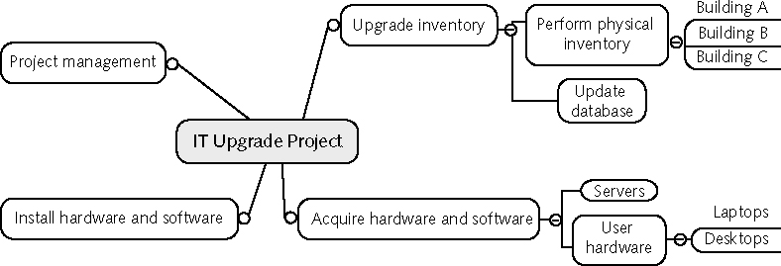
Sample Mind-Mapping Approach for Creating a WBS

Slide 24
The WBS Dictionary and Scope Baseline
Many WBS tasks are vague and must be explained more so people know what to do and can estimate how long it will take and what it will cost to do the work
A WBS dictionary is a document that describes detailed information about each WBS item
The approved project scope statement
WBS
WBS dictionary form the scope baseline, which is used to measure performance in meeting project scope goals

Slide 25
Advice for Creating a WBS and WBS Dictionary
A unit of work should appear at only one place in the WBS
The work content of a WBS item is the sum of the WBS items below it
A WBS item is the responsibility of only one individual,

Slide 26
Advice for Creating a WBS and WBS Dictionary (continued)
Project team members should be involved in developing the WBS
When required for clarity WBS items must be documented in a WBS dictionary to ensure accurate understanding of the scope of work included and not included in that item
The WBS must be a flexible tool to accommodate inevitable changes

Slide 27
Assignment Creating a WBS
Create a simple WBS for the main high-level deliverables for the ACME project.
Prepare to create a block diagram or mind-map on this and put on white board.

Slide 28
What Went Wrong?
A project scope that is too broad and grandiose can cause severe problems
Scope creep and an overemphasis on technology for technology’s sake resulted in the bankruptcy of a large pharmaceutical firm, Texas-based FoxMeyer Drug
In 2001, McDonald’s fast-food chain initiated a project to create an intranet that would connect its headquarters with all of its restaurants to provide detailed operational information in real time; after spending $170 million on consultants and initial implementation planning, McDonald’s realized that the project was too much to handle and terminated it

Slide 29
Verifying Scope
Scope verification involves formal acceptance of the completed project scope by the stakeholders
Acceptance requires customer inspection and sign-off on key deliverables

Slide 30
Controlling Scope
To control changes to the project scope
Goals of scope control are to:
Influence the factors that causing scope changes
Use integrated change control
Manage changes on occurrence
Variance is the difference between planned and actual performance (should be small)

Slide 31
Best Practices for Avoiding Scope Problems
1. Keep the scope realistic. Don’t make projects so large that they can’t be completed. Break large projects down into a series of smaller ones.
2. Involve users in project scope management. Assign key users to the project team and give them ownership of requirements definition and scope verification.
3. Use off-the-shelf hardware and software whenever possible. Many IT people enjoy using the latest and greatest technology, but business needs, not technology trends, must take priority. (Solar technology-Solyndra)
4. Follow good project management processes. As described in this chapter and others, there are well-defined processes for managing project scope and others aspects of projects.

Slide 32
Suggestions for Improving User Input
Develop a good project selection process and insist that sponsors are from the user organization
Have users on the project team in important roles
Have regular meetings with defined agendas, and have users sign off on key deliverables presented at meetings
Deliver something to users and sponsors on a regular basis
Don’t promise to deliver when you know you can’t
Co-locate users with developers

Slide 33
Suggestions for Reducing Incomplete and Changing Requirements
Develop and follow a requirements management process
Use techniques such as prototyping, use case modeling to get more user involvement
Put requirements in writing and keep them current
Create a requirements management database for documenting and controlling requirements

Slide 34
Suggestions for Reducing Incomplete and Changing Requirements (continued)
Provide adequate testing and conduct testing throughout the project life cycle
Review changes from a systems perspective
Emphasize completion dates to help focus on what’s most important
Allocate resources specifically for handling change requests/enhancements

Slide 35
Chapter Summary
Project scope management includes the processes required to ensure that the project addresses all the work required, and only the work required, to complete the project successfully
Main processes include:
Collect requirements
Define scope
Create WBS
Verify scope
Control scope

